Slide 1
Professor
Jorge Alfonso Meléndez Acuña

Slide 2
Welcome
Network Science offers a general and powerful methodology for modeling and representing simple and complex interactions through a common language and different methods for attempting to solve common problems.

Slide 3
3
Schedule
Network Science for Data Analytics
Unit 1
Introduction to Network Analysis
Unit 2
Centrality
Measures
Unit 3
Introduction to Network Models
Unit 4
Community Detection
Unit 5
Error and Attack Tolerance
Unit 6
Graph Machine Learning
Introduction to
Data Science
Basic Concepts of Graph Theory
Hubs
Communities
Vulnerability in networks
Machine Learning with Graphs
Introduction to Network Science
Small Worlds
Network Models
Deep Learning with Graphs

Slide 4
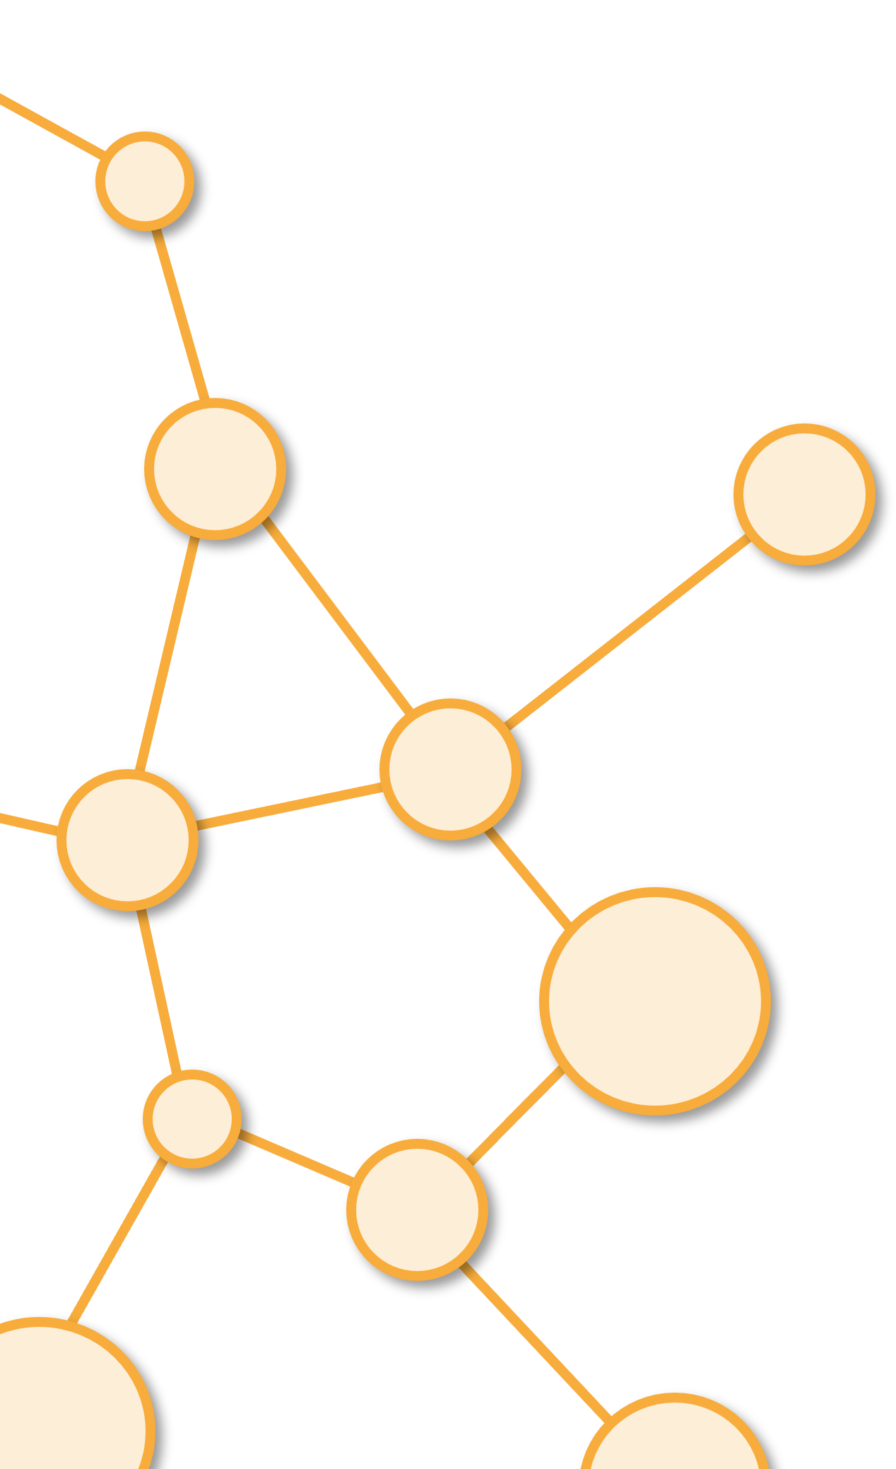
Introduction to Network Analysis
Unit 1

Slide 5
Outline
2. Introduction to Network Science: Networks in the real world

Slide 6
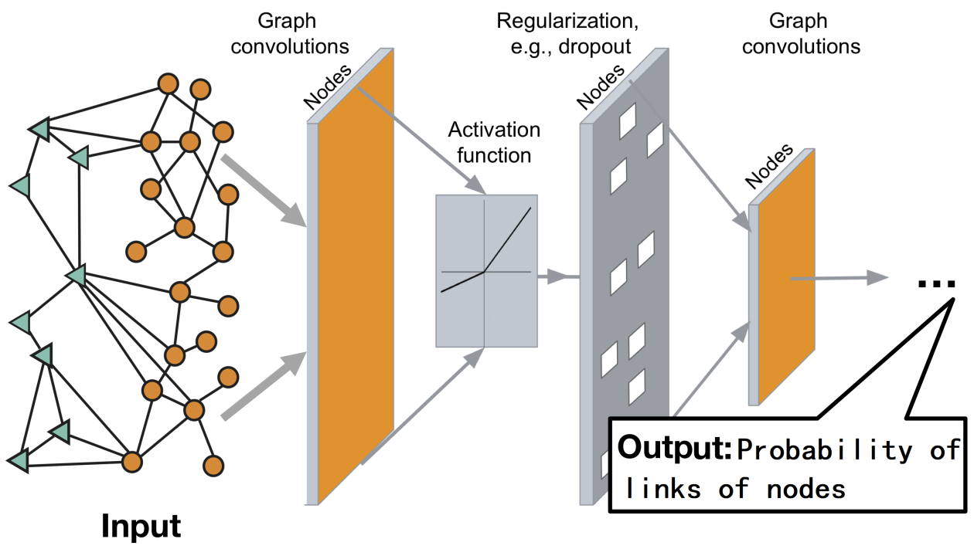
Reference: Jure Leskovec, Stanford CS224W: Machine Learning with Graphs.

Slide 7
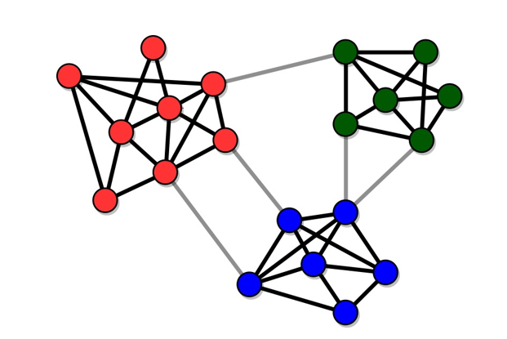
What is a Network?
Nodes
Links
Reference: Community detection I. University of Edinburgh's School of Informatics.

Slide 8
Nodes

Slide 9
And Links

Slide 10
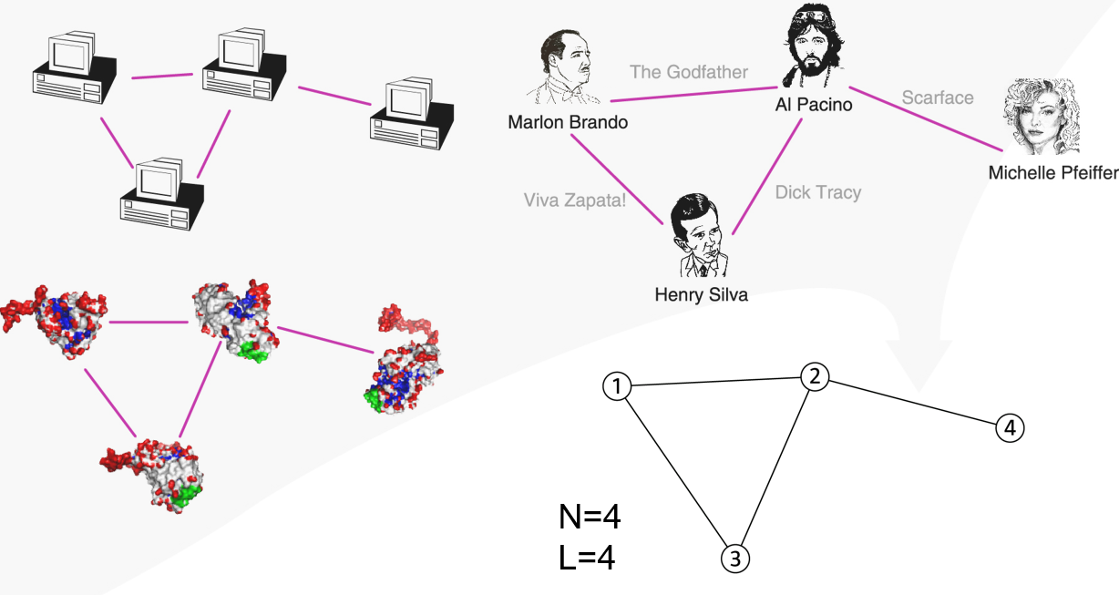
Common Language
N: nodes, L: links
Reference: Albert-László Barabási. (2012). Network Science. Image 2.3 – p. 28. Real systems of quite different nature can have the same network representation.

Slide 11
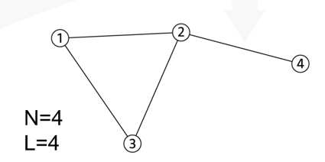
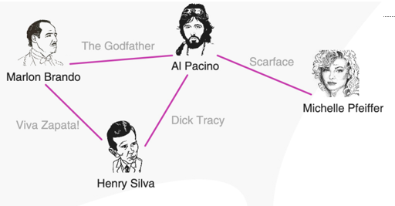
Difference between Networks and Graphs
A network is a Graph with Semantics:
Graph:
Network:
Reference: Albert-László Barabási. (2012). Network Science. Image 2.3 – p. 28. Real systems of quite different nature can have the same network representation.

Slide 12
Terminology
Mathematics:
Graph
Vertex
Edge
Physics:
Network
Node
Edge
Comp. Science:
Network
Node
Link
Social Science:
Network
Actor
Tie

Slide 13
Examples of Networks

Slide 14


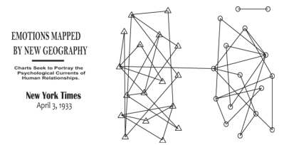
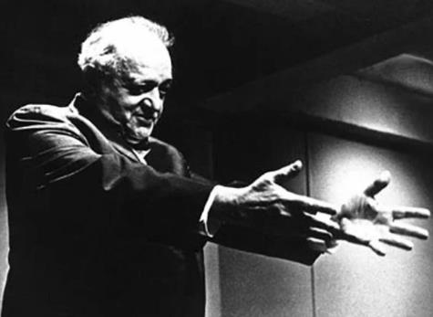

Social Networks
Video School Relations
References: 1. Photo of Jacob Levy Moreno. 2. Who Shall Survive?: A New Approach to the Problem of Human Interrelation by J. L. Moreno. 3. Sociogram representing friendship among school pupils (original title and image accompanying Jacob Moreno's interview by the New York Time, 1933).

Slide 15

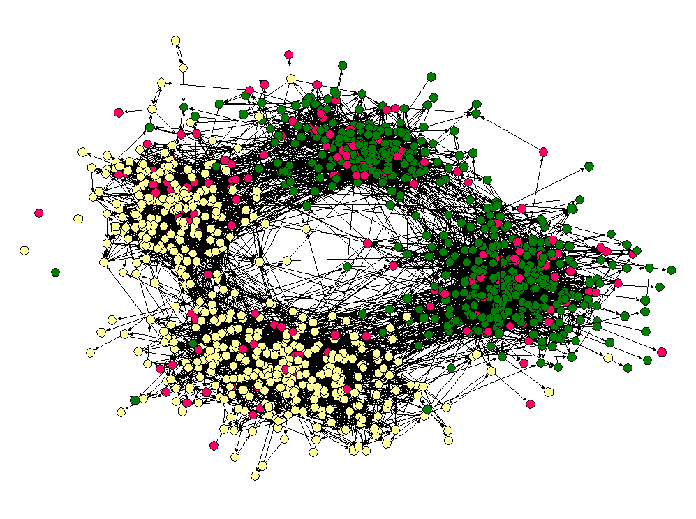
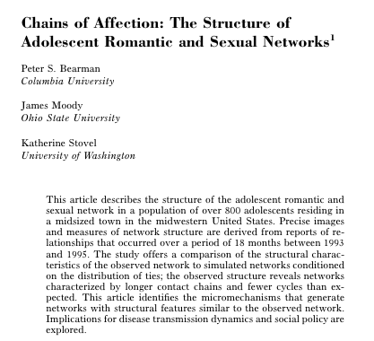
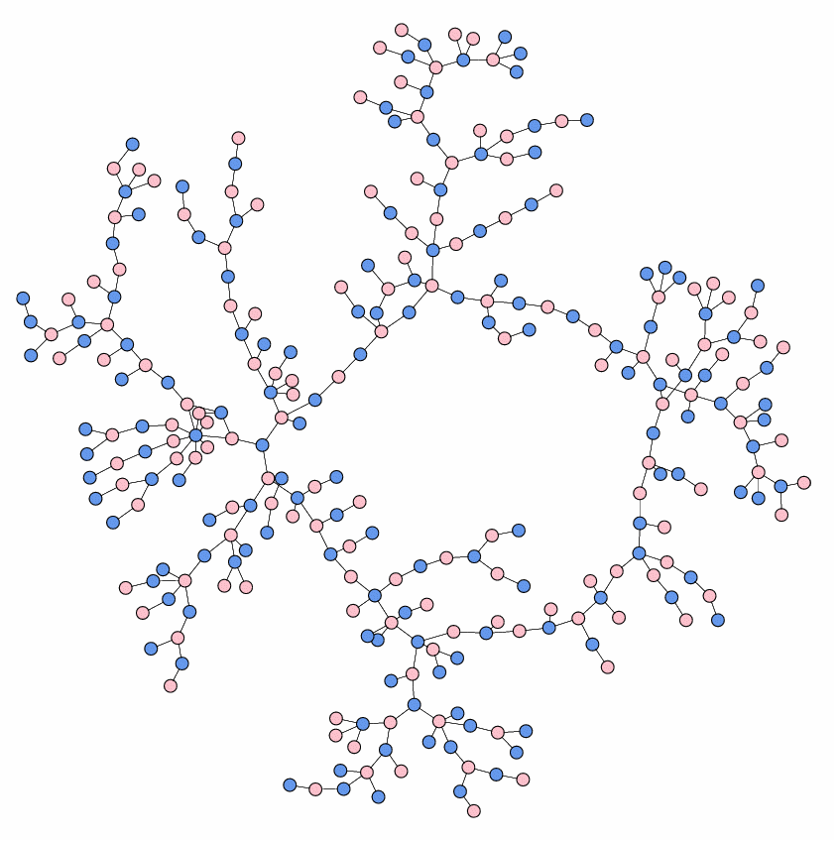
Social Networks
James Moody (2004)
High School Friendship
High School Dating (AIDS)
References: 1. High school friendship. Gallery of network images. 2. High school dating. Gallery of network images. 3. Photo of James Moody.

Slide 16
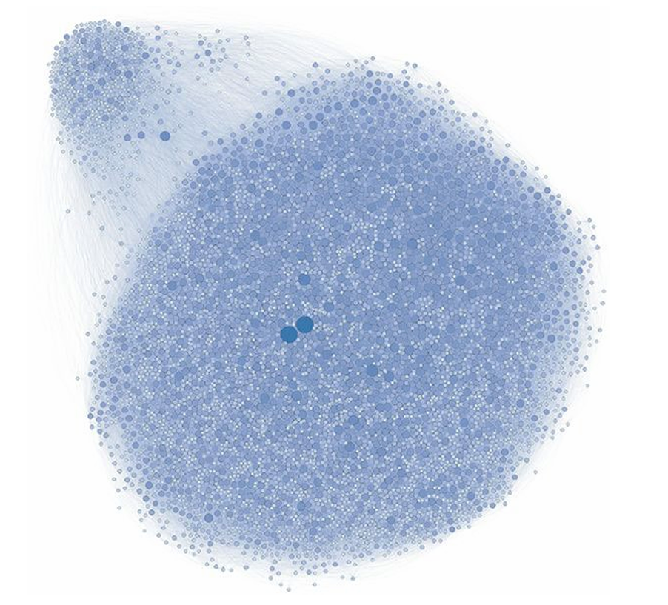
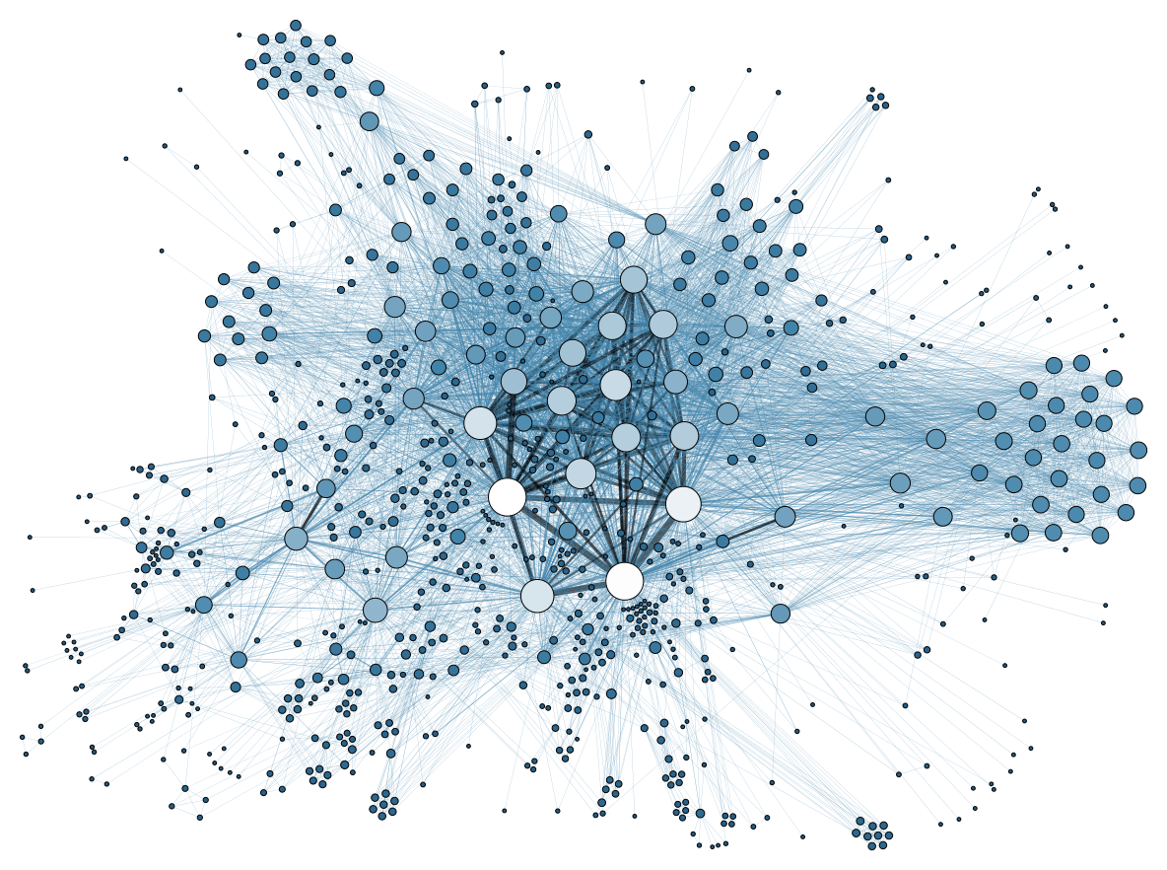



Social Networks (Facebook-Twitter)
Animated Networks
References: 1. Kompleksne mreže (Complex networks) – Facebook. 2. Graph representing the metadata of thousands of archive documents, documenting the social network of hundreds of League of Nations personals.

Slide 17
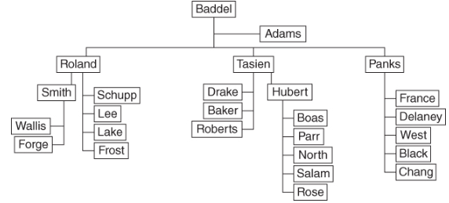
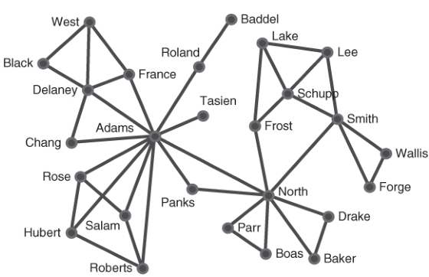
Organizational Networks
Formal vs Informal Communications
Adams and North
References: McCulloh, I.; Armstrong, H. & Johnson, A. (2013). Social Network Analysis with Applications.

Slide 18
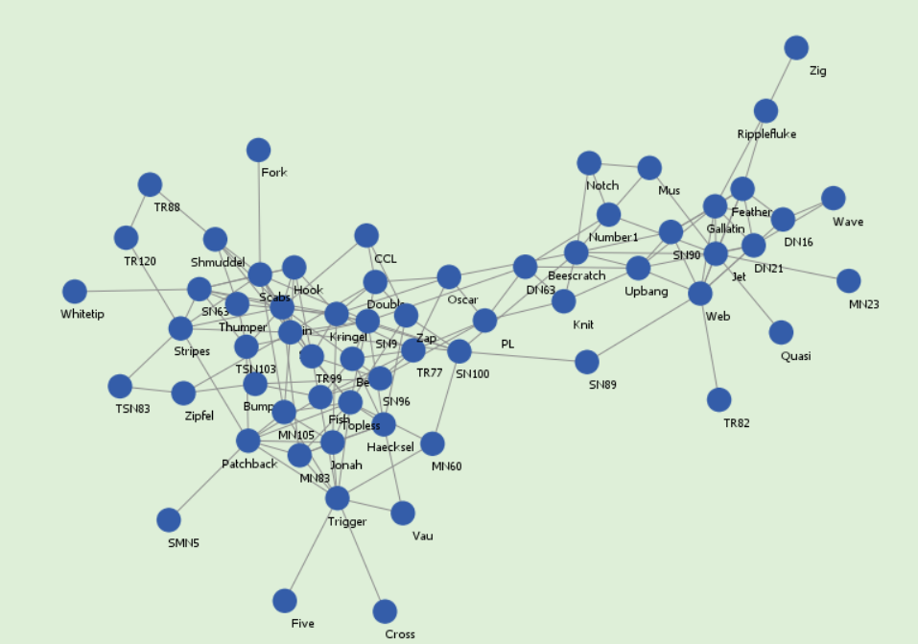
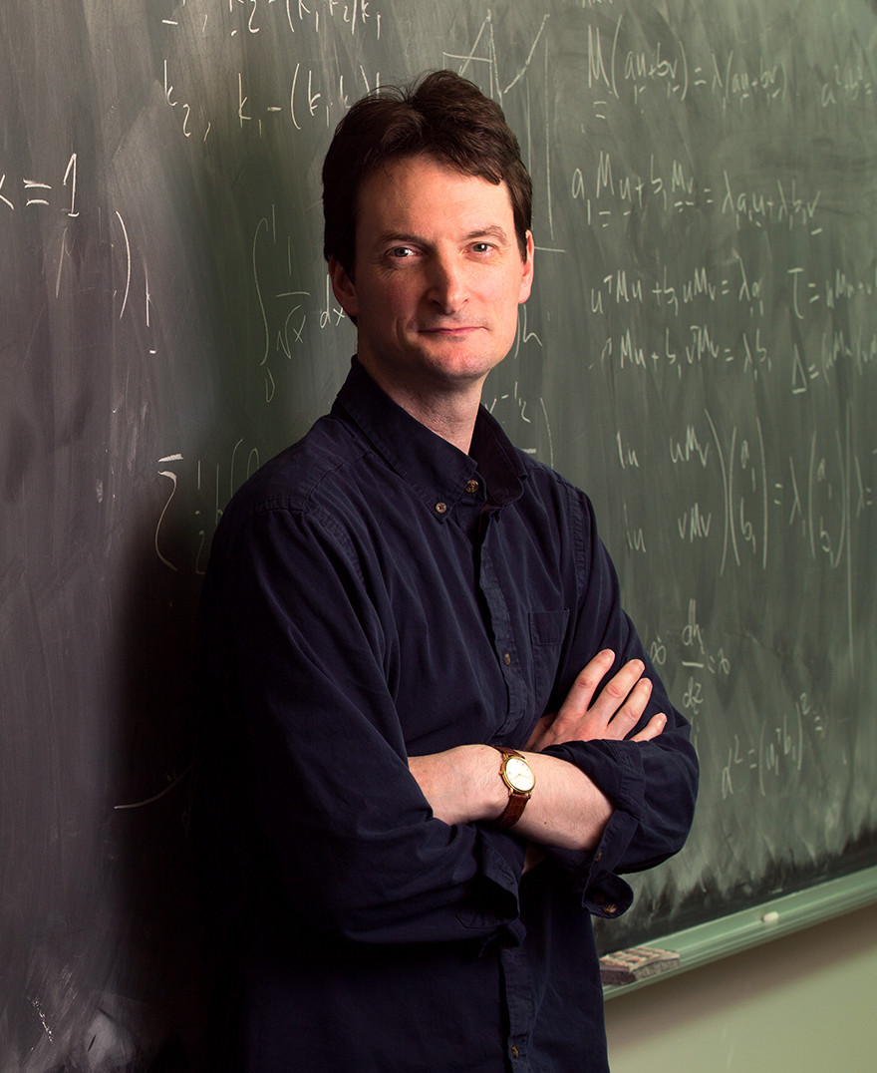
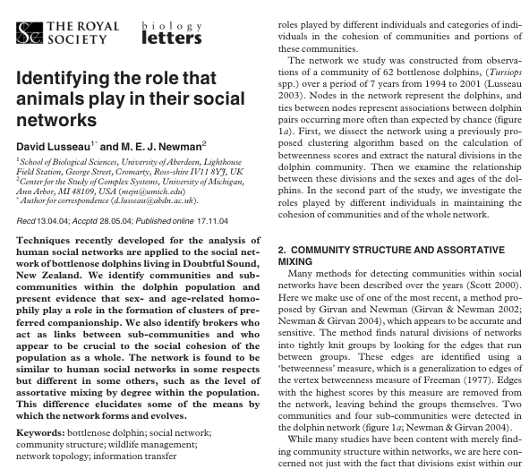
Dolphins
Mark Newman
Veritasium Small World Networks
References: 1. To see a similar example of a dolphin network A Network for Dolphins – Information Visualization 2. Photo of Mark Newman. University of California. 3. Lusseau, D. & Newman, M.E.J. (2004). Identifying the role that animals play in their social networks.

Slide 19
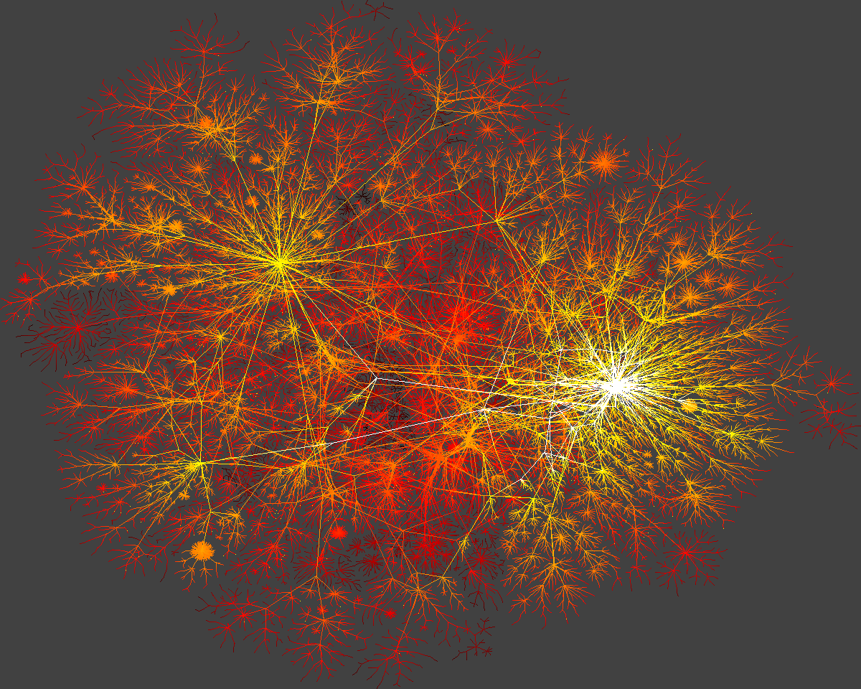
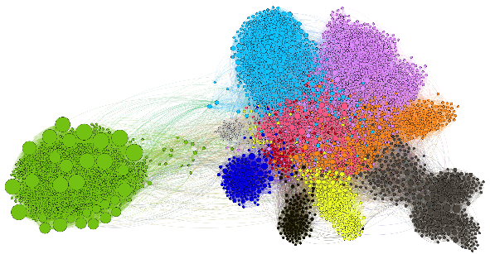
Technological Networks (Internet)
References: 1. Network connectivity. CAIDA's Annual Report for 1998. 2. شبکه‌های حمل و نقل . (Transportation networks).

Slide 20
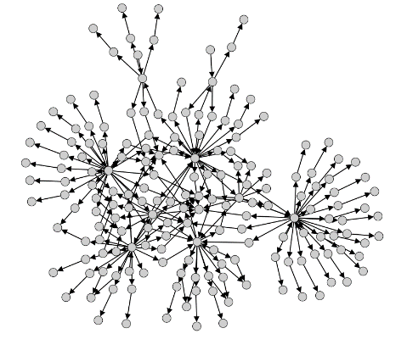

Technological Networks (www, World Wide Web)
References: 1. A network of pages on a corporate website. 2. Combating Cyberattacks In The Age Of Globalization.

Slide 21
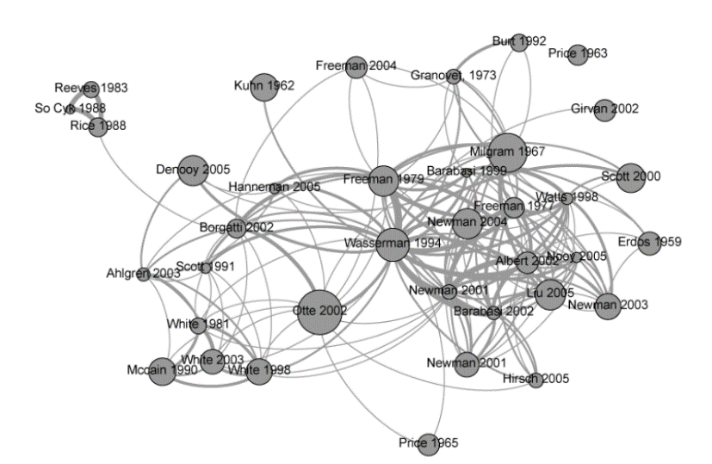
Knowledge Networks (Co-citation)
Two papers are co-cited if they are both cited by the same, third paper.
Referenfe: Co-citation analysis for Social Network Analysis.

Slide 22
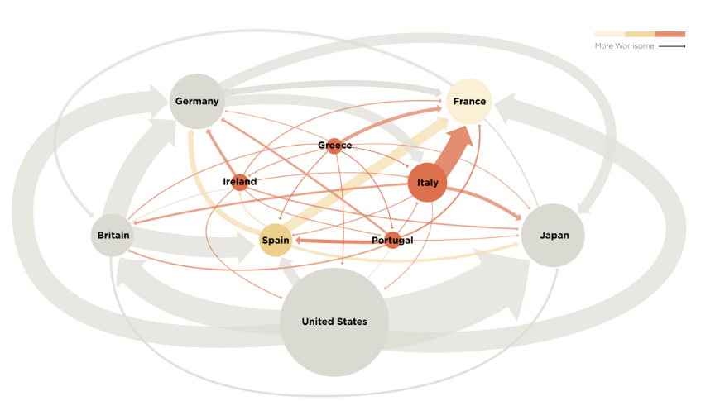
Economic Networks
Amount of Trade between some European Countries and Japan.
Reference: Euro Zone Debt Crisis Visualized | Overview: It's all connected.

Slide 23
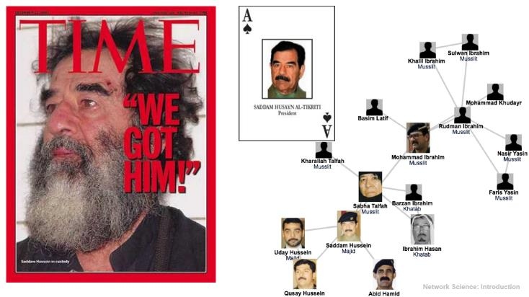
Terrorist Networks
(Saddam Hussein)
References: 1. Time Magazine Saddam Hussein "We Got Him!“. 2. The network of Saddam Hussein.

Slide 24
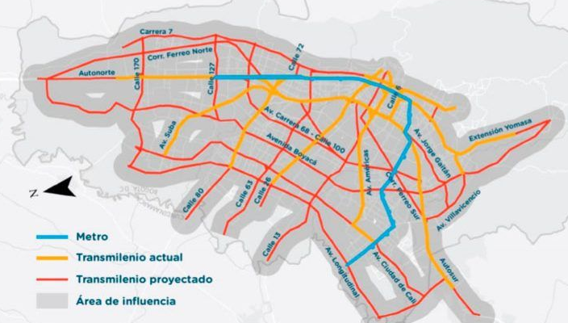
Transportation Networks
Reference: Secretaría Distrital de Movilidad. (2017). Futura red de transporte público masivo (2050). Informe de integración de proyectos de transporte masivo.

Slide 25
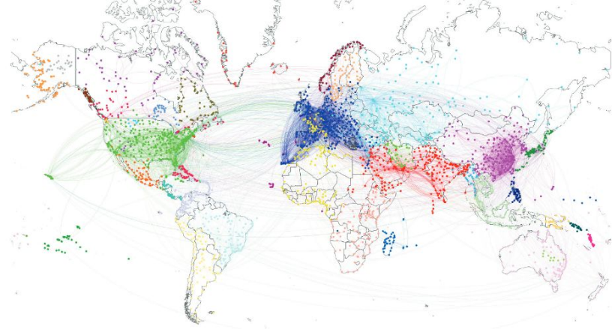
Transportation Networks
Dynamic Network
Reference: Lambiotte, R., Schaub, M. (2022). Modularity and Dynamics on Complex Networks. Research Gate.

Slide 26
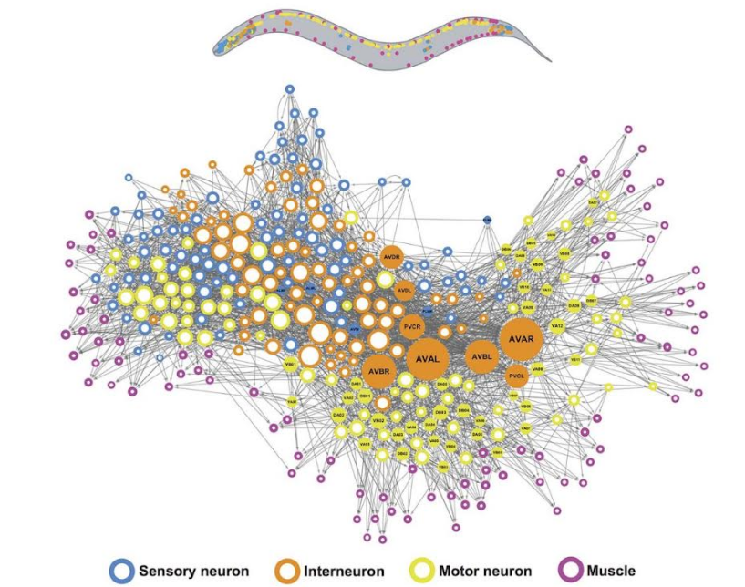
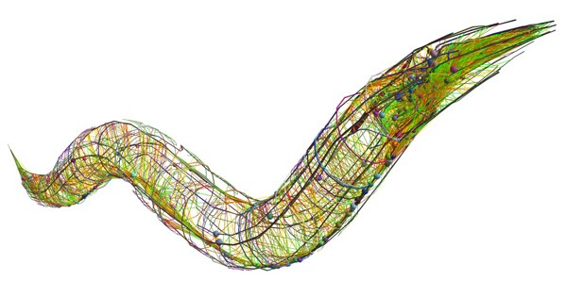
Biological Networks
References: 1. Annelids, the segmented worms, are a large and diverse group. 2. Network control principles predict neuron function in the Caenorhabditis elegans connectome.

Slide 27
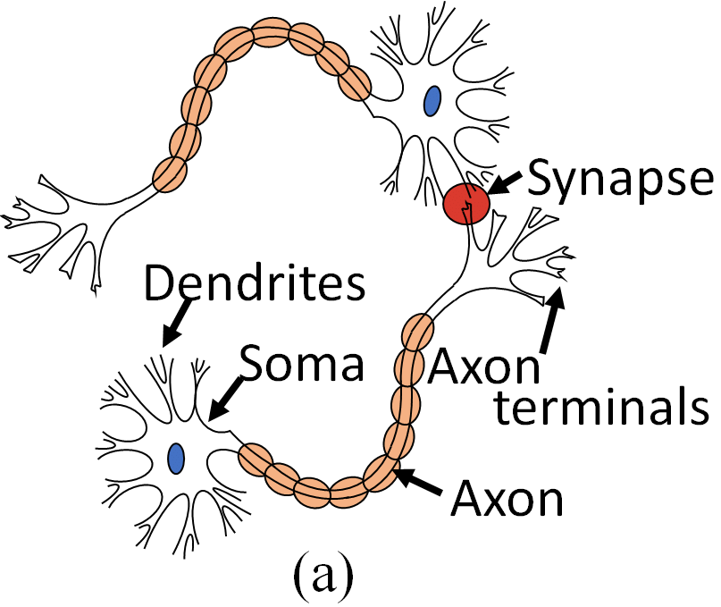
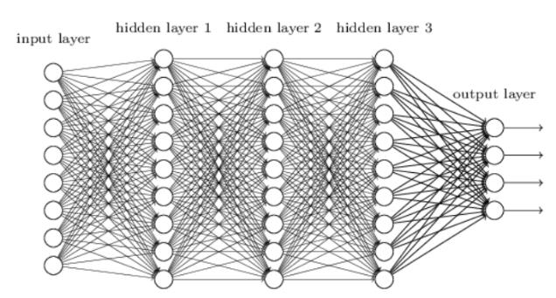
Neural Networks
Reference: An Adiabatic Capacitive Artificial Neuron with RRAM-based Threshold Detection for Energy-Efficient Neuromorphic Computing.

Slide 28
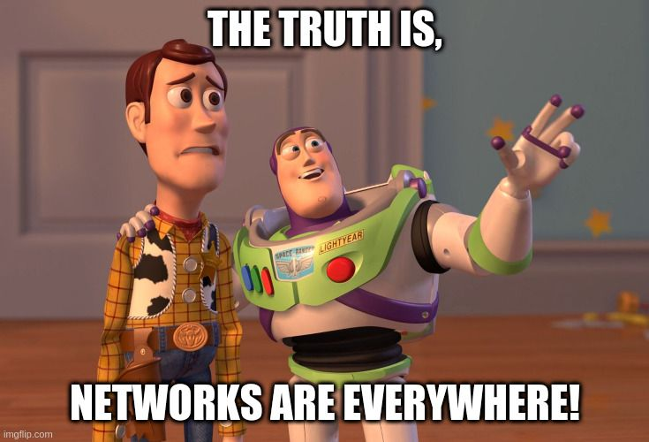
Reference: Meme created with imgflip.com X, X Everywhere Memes - Imgflip

Slide 29
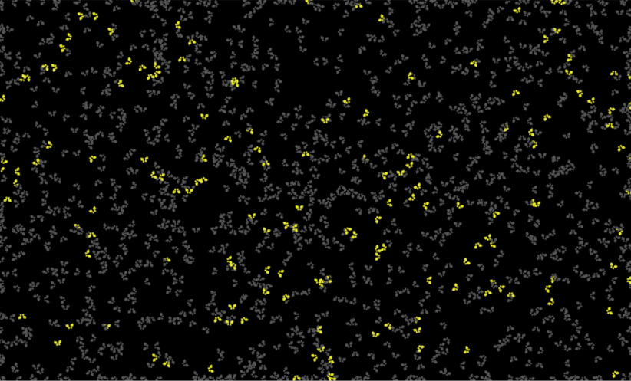
Power of Networks
Behind each Complex System there is a network defining the systems Interactions.
Link to Fire Fly Model
Reference: Screenshots of NetLogo fireflies model interface.

Slide 30

Applications
Reference: Greenbutterfly. Communication technology for internet business. Global world network and telecommunication on earth cryptocurrency and blockchain and IoT. Elements of this image furnished by NASA. Shutterstock.

Slide 31
Robustness of a Network
1

Slide 32
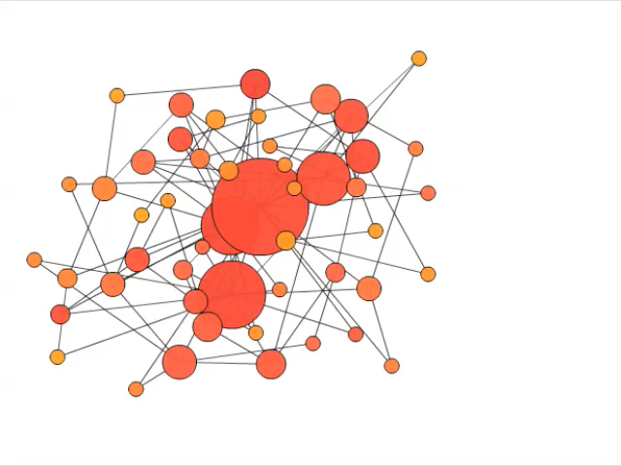
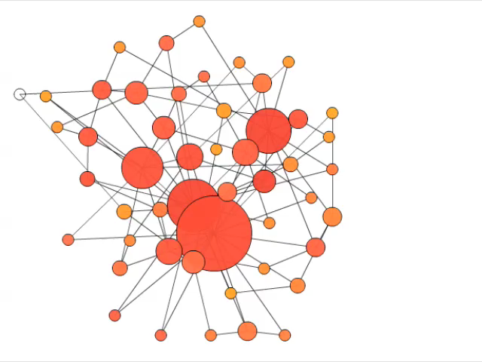
Robustness
Random Attack
Hub Attack
Reference: Albert, Jeong, Barabási, Nature 406 378 (2000)

Slide 33
Diffusion on a Network
2

Slide 34
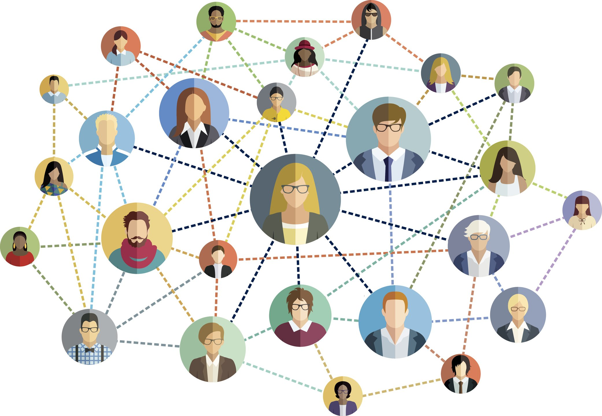
Biological and Social Contagion
Small World Model
Diffusion Network Models
Reference: aelitta. (2016). Red social - ilustración vectorial. - Ilustración de stock. iStock.

Slide 35
Predictions
3

Slide 36
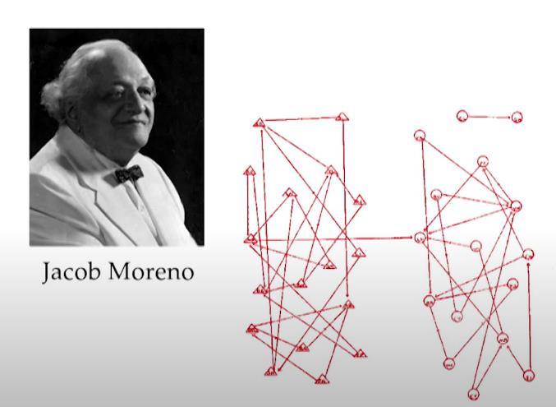
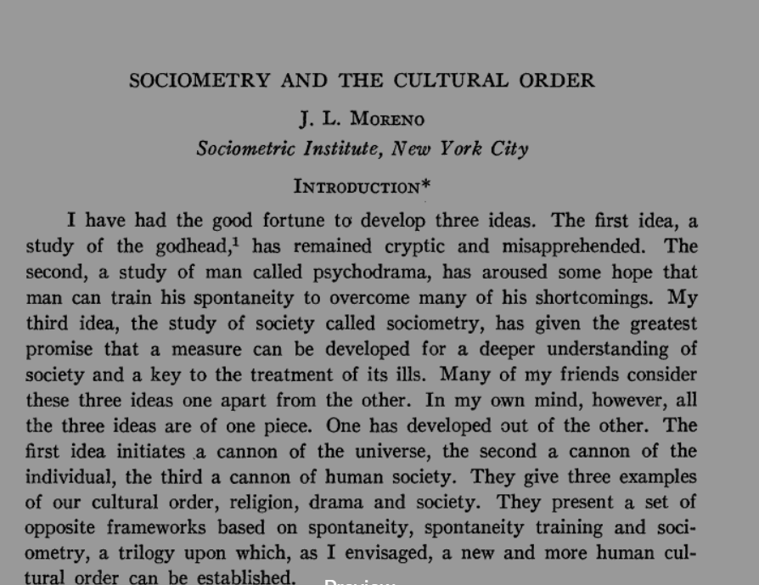
High School Example
Link to Model
Reference:1. Moreno, J.L. (1943). Sociometry and the cultural order. 2. Photo of Jacob Moreno. 3. Moreno, J. J.L.’s sociogram of a fourth-grade class.

Slide 37
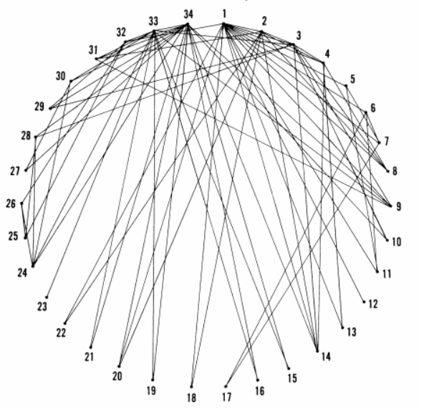
Zachary’s Karate Club
The network captures 34 members of a karate club, documenting links between pairs of members who interacted outside the club.
During the study a conflict arose between the administrator "John A" and instructor "Mr. Hi“, which led to the split of the club into two.
Half of the members formed a new club around Mr. Hi; members from the other part found a new instructor or gave up karate.
Reference: Zachary, W. (1976). Social Network Model of Relationships in the Karate Club.

Slide 38
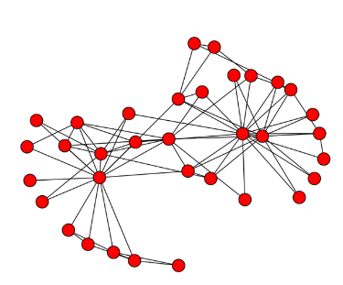
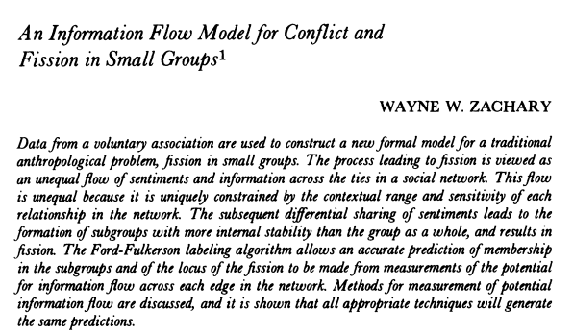
Zachary’s Karate Club
Based on collected data Zachary correctly assigned all but one member of the club to the groups they actually joined after the split.
Link to Model
Reference: 1. Michael, J. H. (1997). Labor dispute reconciliation in a forest products manufacturing facility. Forest Products Journal, 47(11-12), 41-45. 2. Journal of Anthropological Research, Vol. 33, No. 4 (Winter, 1977), pp. 452-473. Published by: University of New Mexico.

Slide 39
Organizational Networks
4

Slide 40
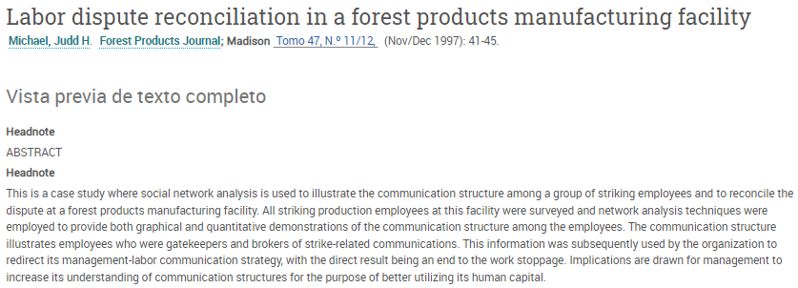
Strike
The importance of informal
communication structures
within a firm
A small wood-processing firm in which management proposed a new compensation package.
This led to a strike, letting management believe that the communication to the workers had been far from optimal
They decided to have the social network analyzed, the workers were asked to indicate how often and with whom they discussed the strike
Reference: Judd, M. (1997). Labor dispute reconciliation in a forest products manufacturing facility. Forest Products Journal.

Slide 41
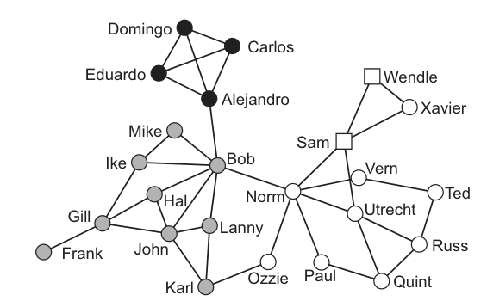
Strike
Link to Model
Reference: Nooy, W., Mrvar, A., & Batagelj, V. (2018). Exploratory Social Network Analysis with Pajek: Revised and Expanded Edition for Updated Software (3rd ed.). Cambridge: Cambridge University Press.

Slide 42
Political Networks
5

Slide 43

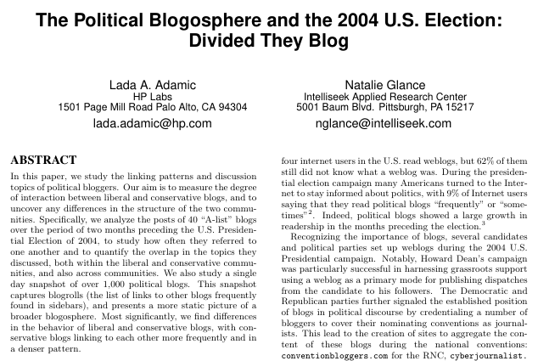
Political Networks
Lada Adamic
Computational Social Scientist at Facebook
Link Gephi BlogModel
Video Network Analysis (1:12)
Reference: 1. Photo of Lada Adamic. Ladamic. 2. Adamic, L., Glance, N. (2005). The political blogosphere and the 2004 U.S. Election: Divided they blog.

Slide 44
Communities
6

Slide 45
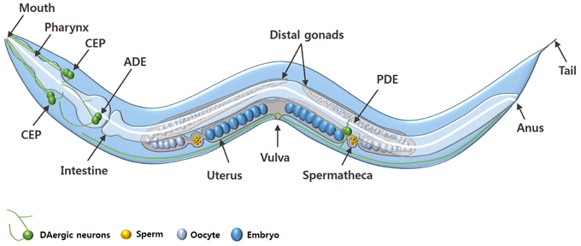
C. Elegans
Caenorhabditis elegans, often abbreviated as C. elegans, is a species of transparent nematode, commonly known as a round worm.
C. elegans is extensively studied in biology and neuroscience due to its simple and well-understood anatomy.
Its relatively simple nervous system makes it an excellent model for studying basic principles of neural function and behavior.
Link Gephi BlogModel
Reference: Chege. P., McColl. G. (2014). Caenorhabditis elegans: a model to investigate oxidative stress and metal dyshomeostasis in Parkinson's disease. Frontiers.

Slide 46
Additional Networks
Game of Thrones
Flavor Network
Dolphin Network
Cora dataset
Netscience
Protein Protein

Slide 47
Worldwide Impact
7

Slide 48
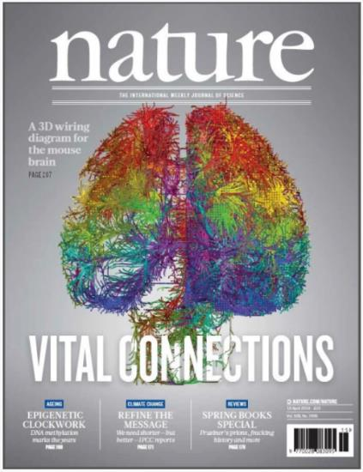
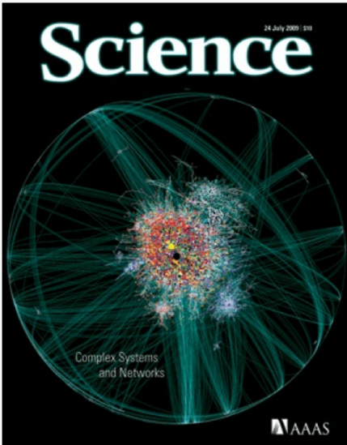
Top World Magazines (2009)
References: 1. Nature. Vital connections. Volume 508 Issue 7495, 10 April 2014. Nature. 2. Science. Volume 325 Issue 5939, 24 Jul 2009. Science.

Slide 49
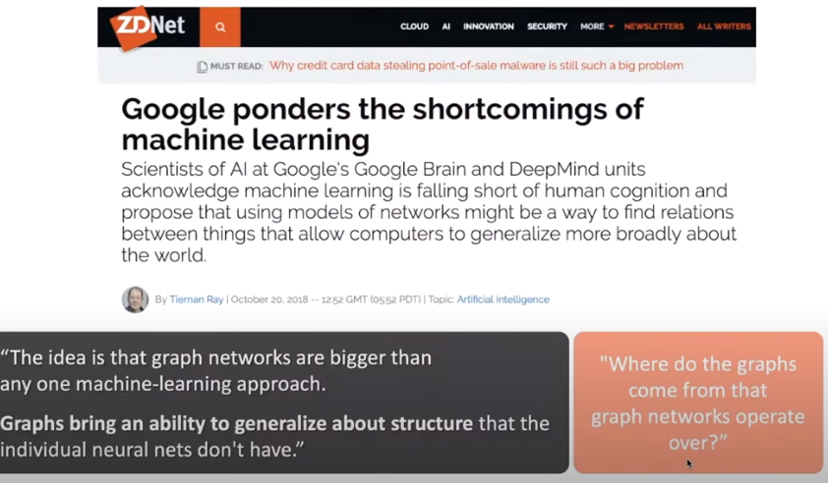
Google Forecast (2019)
Reference: Screenshot of: Ray. T. (2018). Google ponders the shortcomings of machine learning. ZDNet.

Slide 50

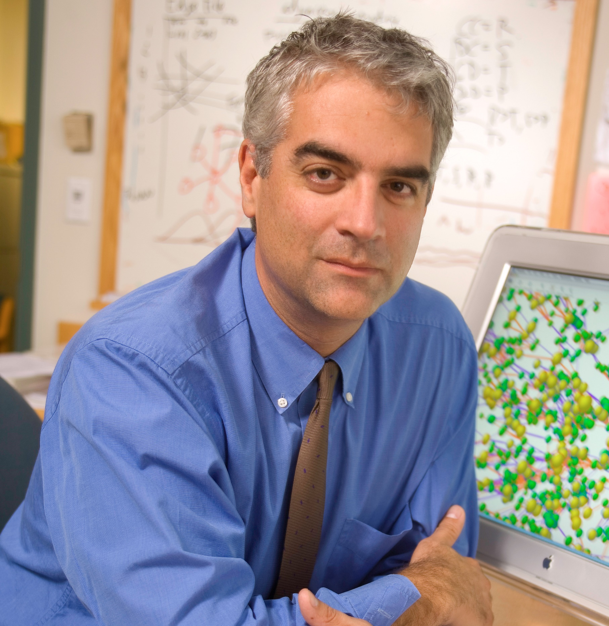
Worldwide Impact
Epidemic prediction, AH1N1
Obesity is socially contagious
Video AH1N1 (0:51)
Video Obesity( 0:30)
Video Vespignani (3:15)
Video Cristakis: (4:12) (Begins at: 19:10)
Reference: 1. Photo of Alessandro Vespignani. Boston University. 2. Photo of Nicholas Christakis. Wikipedia.

Slide 51
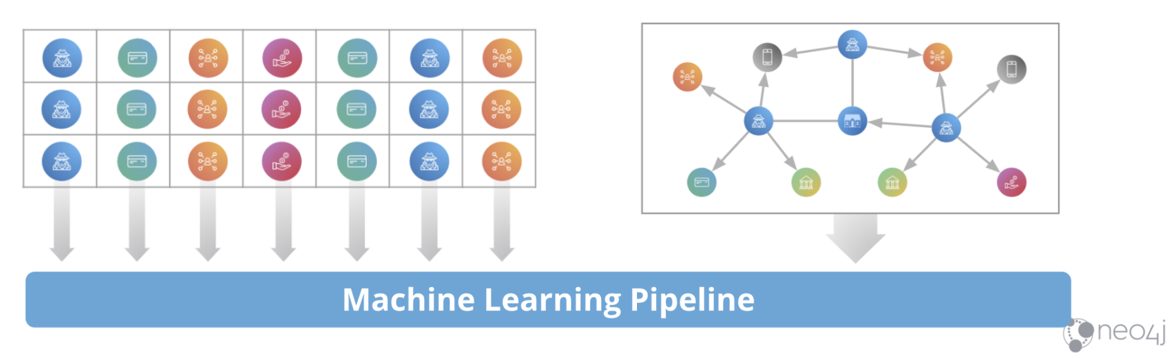
Data Science and Network Science
Reference: Hodler, A., Frame, A. (2020) Insider Guide to Graph Data Science: First, a Brief Overview. [Better Predictions with Graphs]. Neo4j.

Slide 52
Rather than thinking of the world as a set of isolated datapoints.
(Data Science)

Slide 53
We think of networks
and relations between its entities.
(Network Science)

Slide 54
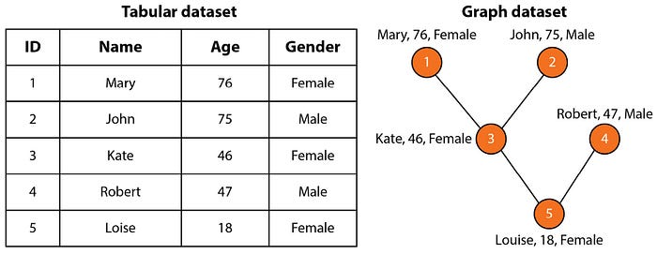
These relational structures of the domain allow us to build more accurate models of the underlying phenomena.
Reference: AMA. (2024). Simplifying Graph Learning (GNNs): Understanding the Basics and Their Applications. [Figure 1.4 Representation of Family tree in Tabular versus a graph dataset.]. Medium.

Slide 55





Ciencia de datos
Ciencia de redes
8
Enlace al Modelo con atributos

Slide 56

By explicitly modeling relationships we achieve better performance, more accurate predictions
Reference: Kevin Bacon network. To see a similar network example: The Oracle of Bacon.

Slide 57
A Simple Example

Slide 58

Two Independent Datasets
Set of questions limited
Reference:. Screenshots taken of What kind of useful insights are hidden in the graph data.

Slide 59

Two Connected Datasets
Reference:. Screenshots taken of What kind of useful insights are hidden in the graph data.

Slide 60

New Questions
Reference:. Screenshots taken of What kind of useful insights are hidden in the graph data.

Slide 61

Main Question
How do we take advantage of relational structure for better analysis, prediction and finally understanding?
Jure Leskovec Video
Reference: Photo of Jure Leskovec. Stanford University.

Slide 62
Conclusions
Networks are Ubiquitous.
Behind every complex system → network.
Worldwide Impact.
Network science, future of data Science?

Slide 63



The Promise of Network Science
Duncan Watts
Steven Strogatz
Albert Barabasi
The promise of Network Science
Reference: 1. Photo of Duncan Watts. Knowledge at Wharton. 2. Photo of Steven Strogatz. GaeaPeople. 3. Photo of Barabasi. Twitter.

Slide 64
!
Activities
Taller sábado:
Tarea:
Foros: comentar
ConceptosBásicosRedes
Cuaderno Jupyter: CaminosEnRedes
Lectura: Las redes nos envuelven, Vito latora
Videos: Master Class Video: The power of Network Science

Slide 65
Good bye
We hope that the information in this study material has contributed to the understanding of the most important concepts of this topic.
We invite you to continue reviewing all the educational materials available on the platform.

Slide 66
References
Adamic, L., Glance, N. (2005). The political blogosphere and the 2004 U.S. Election: Divided they blog. https://dl.acm.org/doi/10.1145/1134271.1134277
Albert-László Barabási. (2012). Network Science. Image 1.2a and 1.2b – p. 5. Real systems of quite different nature can have the same network representation. https://eravilaipnada.wordpress.com/wp-content/uploads/2016/01/barabasi-2012.pdf
AMA. (2024). Simplifying Graph Learning (GNNs): Understanding the Basics and Their Applications. [Figure 1.4 Representation of Family tree in Tabular versus a graph dataset.]. Medium. https://medium.com/@amaboh/simplifying-graph-learning-gnns-understanding-the-basics-and-their-applications-ae152eed57a3
An Adiabatic Capacitive Artificial Neuron with RRAM-based Threshold Detection for Energy-Efficient Neuromorphic Computing - Scientific Figure on ResearchGate. Available from: https://www.researchgate.net/figure/a-Biological-Neurons-connected-by-Synapses-Soma-neuron-body-b-Typical-Artificial_fig1_358306650
Chege. P., McColl. G. (2014). Caenorhabditis elegans: a model to investigate oxidative stress and metal dyshomeostasis in Parkinson's disease. Frontiers. https://www.frontiersin.org/journals/aging-neuroscience/articles/10.3389/fnagi.2014.00089/full
Co-citation analysis for Social Network Analysis. https://eduinf.eu/2012/03/15/co-citation-analysis-of-the-topic-social-network-analysis/
Combating Cyberattacks In The Age Of Globalization. https://www.hoover.org/research/combating-cyberattacks-age-globalization

Slide 67
References
Hodler, A., Frame, A. (2020) Insider Guide to Graph Data Science: First, a Brief Overview. [Better Predictions with Graphs]. Neo4j. https://neo4j.com/blog/graph-data-science/insider-guide-graph-data-science-brief-overview/
Journal of Anthropological Research, Vol. 33, No. 4 (Winter, 1977), pp. 452-473. Published by: University of New Mexico.
Judd, M. (1997). Labor dispute reconciliation in a forest products manufacturing facility. Forest Products Journal. https://pure.psu.edu/en/publications/labor-dispute-reconciliation-in-a-forest-products-manufacturing-f
Lambiotte, R., Schaub, M. (2022). Modularity and Dynamics on Complex Networks. Research Gate. https://www.researchgate.net/publication/357224672_Modularity_and_Dynamics_on_Complex_Networks
Lusseau, D. & Newman, M.E.J. (2004). Identifying the role that animals play in their social networks.
Michael, J. H. (1997). Labor dispute reconciliation in a forest products manufacturing facility. Forest Products Journal, 47(11-12), 41-45.
Moreno, J.L. (1943). Sociometry and the cultural order.
Nature. Vital connections. Volume 508 Issue 7495, 10 April 2014. Nature. https://www.nature.com/nature/volumes/508/issues/7495
Network connectivity. CAIDA's Annual Report for 1998. https://www.caida.org/about/annualreports/1998/
Network control principles predict neuron function in the Caenorhabditis elegans connectome. https://barabasi.com/media/pub_imports/files/919.pdf

Slide 68
References
Newman, M. E. J. (2003). The Structure and Function of Complex Networks.
Nooy, W., Mrvar, A., & Batagelj, V. (2018). Exploratory Social Network Analysis with Pajek: Revised and Expanded Edition for Updated Software (3rd ed.). Cambridge: Cambridge University Press. https://www.cambridge.org/core/books/exploratory-social-network-analysis-with-pajek/6F8EE2512CB7C6D233DB2DAC3886D4F5
Ray. T. (2018). Google ponders the shortcomings of machine learning. ZDNet. https://www.zdnet.com/article/google-ponders-the-shortcomings-of-machine-learning/
Science. Volume 325 Issue 5939, 24 Jul 2009. Science. https://www.science.org/toc/science/325/5939
Sociogram representing friendship among school pupils (original title and image accompanying Jacob Moreno's interview by the New York Time, 1933). https://www.researchgate.net/figure/Sociogram-representing-friendship-among-school-pupils-original-title-and-image_fig1_333415495
Zachary, W. (1976). Social Network Model of Relationships in the Karate Club. https://www.researchgate.net/publication/248519014_An_Information_Flow_Model_for_Conflict_and_Fission_in_Small_Groups1
Ziqi Wang. (2022). A Network for Dolphins. Information Visualization, Pratt Institute. https://studentwork.prattsi.org/infovis/visualization/a-network-for-dolphins/

Slide 69
Image copyright
A network of pages on a corporate website http://barmpalias.net/teaching/courses/network_ucas_notes.pdf
aelitta. (2016). Red social - ilustración vectorial. - Ilustración de stock. iStock. Ilustración de Red Social Ilustración Vectorial y más Vectores Libres de Derechos de Conexión - Conexión, Red informática, Redes sociales – iStock
Albert, Jeong, Barabási, Nature 406 378 (2000).
Albert-László Barabási. (2012). Network Science. Image 1.2a and 1.2b – p. 5. Real systems of quite different nature can have the same network representation. https://eravilaipnada.wordpress.com/wp-content/uploads/2016/01/barabasi-2012.pdf
Albert-László Barabási. (2012). Network Science. Image 2.3 – p. 28. Real systems of quite different nature can have the same network representation. https://eravilaipnada.wordpress.com/wp-content/uploads/2016/01/barabasi-2012.pdf
AMA. (2024). Simplifying Graph Learning (GNNs): Understanding the Basics and Their Applications. [Figure 1.4 Representation of Family tree in Tabular versus a graph dataset.]. Medium. https://medium.com/@amaboh/simplifying-graph-learning-gnns-understanding-the-basics-and-their-applications-ae152eed57a3
An Adiabatic Capacitive Artificial Neuron with RRAM-based Threshold Detection for Energy-Efficient Neuromorphic Computing - Scientific Figure on ResearchGate. Available from: https://www.researchgate.net/figure/a-Biological-Neurons-connected-by-Synapses-Soma-neuron-body-b-Typical-Artificial_fig1_358306650
Annelids, the segmented worms, are a large and diverse group. http://www.barelyimaginedbeings.com/2012/10/

Slide 70
Image copyright
Chege. P., McColl. G. (2014). Caenorhabditis elegans: a model to investigate oxidative stress and metal dyshomeostasis in Parkinson's disease. Frontiers. https://www.frontiersin.org/journals/aging-neuroscience/articles/10.3389/fnagi.2014.00089/full
Co-citation analysis for Social Network Analysis. https://eduinf.eu/2012/03/15/co-citation-analysis-of-the-topic-social-network-analysis/
Combating Cyberattacks In The Age Of Globalization. https://www.hoover.org/research/combating-cyberattacks-age-globalization
Euro Zone Debt Crisis Visualized | Overview: It's all connected. https://thesocietypages.org/graphicsociology/page/7/
Graph representing the metadata of thousands of archive documents, documenting the social network of hundreds of League of Nations personals. https://upload.wikimedia.org/wikipedia/commons/9/9b/Social_Network_Analysis_Visualization.png
Greenbutterfly. Communication technology for internet business. Global world network and telecommunication on earth cryptocurrency and blockchain and IoT. Elements of this image furnished by NASA. Shutterstock. https://www.shutterstock.com/image-photo/communication-technology-internet-business-global-world-1554021845
High school dating. Gallery of network images. https://websites.umich.edu/~mejn/networks/
High school friendship. Gallery of network images. https://websites.umich.edu/~mejn/networks/

Slide 71
Image copyright
Hodler, A., Frame, A. (2020) Insider Guide to Graph Data Science: First, a Brief Overview. [Better Predictions with Graphs]. Neo4j. https://neo4j.com/blog/graph-data-science/insider-guide-graph-data-science-brief-overview/
Journal of Anthropological Research, Vol. 33, No. 4 (Winter, 1977), pp. 452-473. Published by: University of New Mexico.
Jure Leskovec, Stanford CS224W: Machine Learning with Graphs https://web.stanford.edu/class/cs224w/slides/03-GNN1.pdf
Kompleksne mreže (Complex networks) – Facebook. https://www.fer.unizg.hr/_download/repository/1_Predavanje_2022.pdf
Lambiotte, R., Schaub, M. (2022). Modularity and Dynamics on Complex Networks. Research Gate. https://www.researchgate.net/publication/357224672_Modularity_and_Dynamics_on_Complex_Networks
Moreno, J. J.L.’s sociogram of a fourth-grade class. https://slate.com/technology/2014/10/j-l-moreno-a-psychologists-30s-experiments-invented-social-networking.html
Moreno, J. L. (1934). Who shall survive? A new approach to the problem of human interrelations.
Nature. Vital connections. Volume 508 Issue 7495, 10 April 2014. Nature. https://www.nature.com/nature/volumes/508/issues/7495
Network connectivity. CAIDA's Annual Report for 1998. https://www.caida.org/about/annualreports/1998/
Network control principles predict neuron function in the Caenorhabditis elegans connectome. https://barabasi.com/media/pub_imports/files/919.pdf

Slide 72
Image copyright
Nooy, W., Mrvar, A., & Batagelj, V. (2018). Exploratory Social Network Analysis with Pajek: Revised and Expanded Edition for Updated Software (3rd ed.). Cambridge: Cambridge University Press. https://www.cambridge.org/core/books/exploratory-social-network-analysis-with-pajek/6F8EE2512CB7C6D233DB2DAC3886D4F5
Science. Volume 325 Issue 5939, 24 Jul 2009. Science. https://www.science.org/toc/science/325/5939
Sociogram representing friendship among school pupils (original title and image accompanying Jacob Moreno's interview by the New York Time, 1933). https://www.researchgate.net/figure/Sociogram-representing-friendship-among-school-pupils-original-title-and-image_fig1_333415495
University of Edinburgh's School of Informatics. Community detection I. https://opencourse.inf.ed.ac.uk/sites/default/files/https/opencourse.inf.ed.ac.uk/dbba/2023/08-community-detection-icompressed.pdf
Zachary, W. (1976). Social Network Model of Relationships in the Karate Club. https://www.researchgate.net/publication/248519014_An_Information_Flow_Model_for_Conflict_and_Fission_in_Small_Groups1
شبکه‌های حمل و نقل (Transportation networks). https://dataak.com/blog/%D9%85%D8%A7-%D9%88-%D8%AC%D9%87%D8%A7%D9%86-%D8%B4%D8%A8%DA%A9%D9%87-%D9%87%D8%A7/

Slide 73
Credits
Subject Matter Expert
Instructional Designer
Jorge Alfonso Meléndez Acuña
Angela Maria Arboleda Restrepo
Subject Matter Expert
Graphic Designer
Luis Fernando Niño Vásquez
Tania Valentina Flórez Rincón
First version
Date: April 2025

